Slide 1
Black-footed ferry
1.2 Jo
HPCX73609

Slide 2
Introduction
Communication
Native Habitat
Eating Habits
Size
Why are Black-footed ferrets endangered
Reference

Slide 3
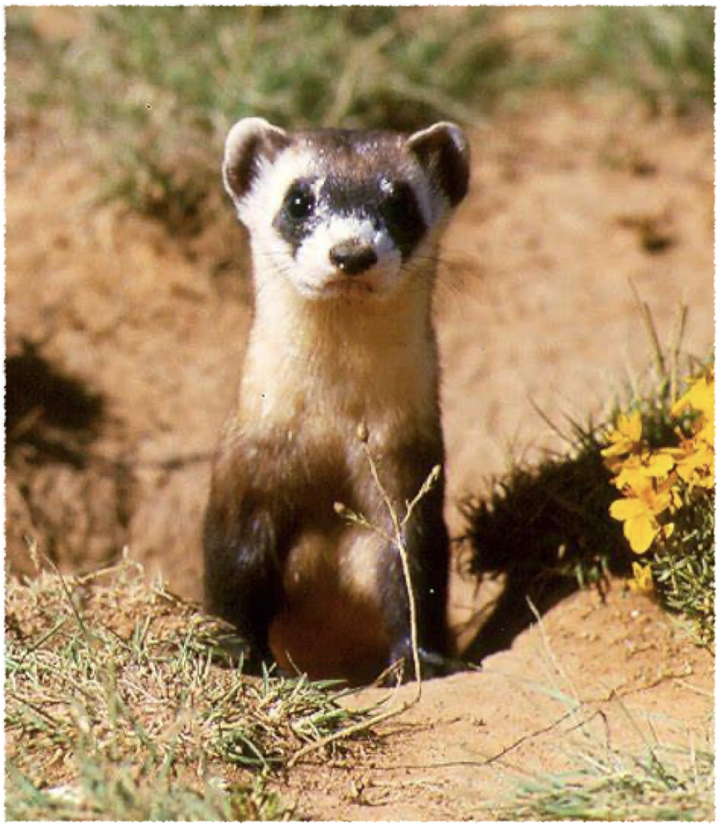
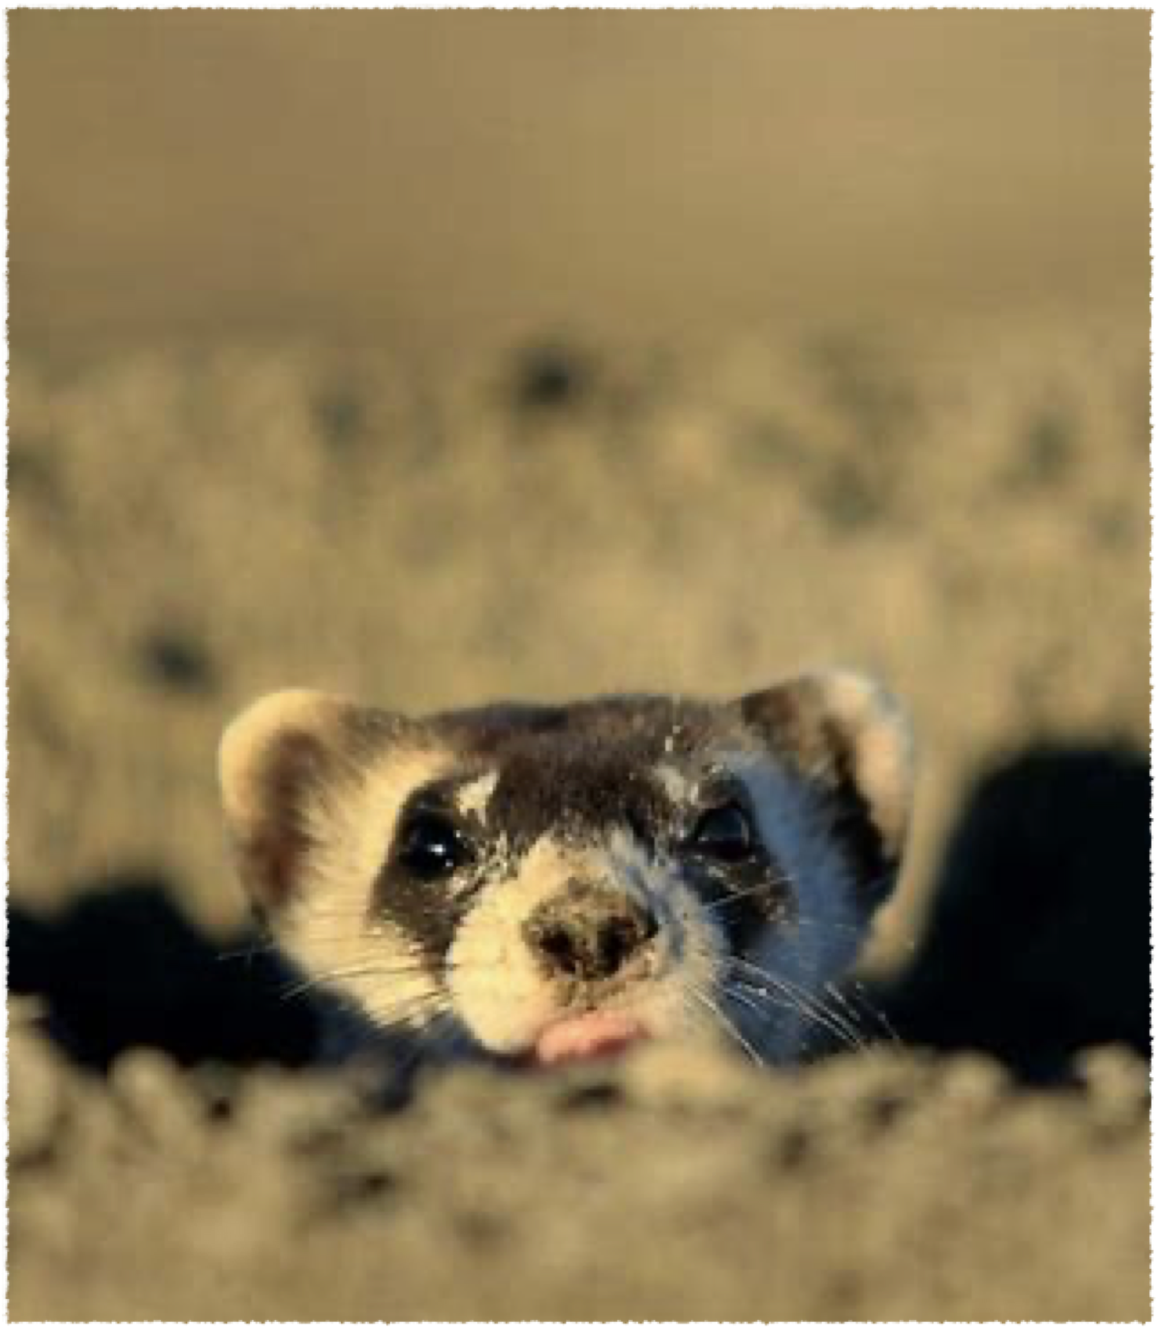
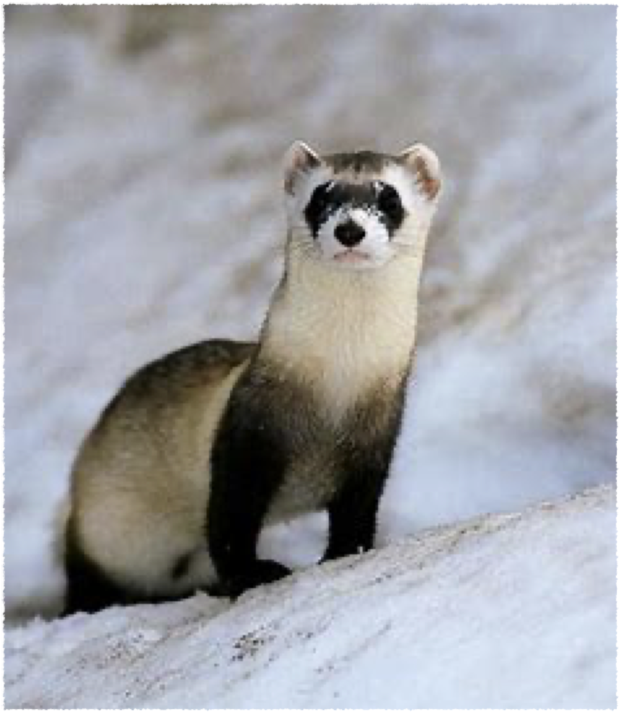
Mammalia
Family-Mutelidae

Slide 4
Communication
A loud chatter
A hiss
whimpering sounds
chortle
alarm call
agitation or fear
encourage the young to follow
breeding

Slide 5
Native Habitat
Reintroduction
North American Great Plains，
southern Canada， northern Mexico
Wyoming, South Dakota, Montana and
Arizona.

Slide 6
Eating Habits
prairie dogs
mice, rats, ground squirrels, rabbits, birds and occasionally reptiles and insects.

Slide 7
Size
About the size of a mink
18 to 24 inches
(Tail 18 to 24 inches long)

Slide 8
Why are Black-footed ferrets endangered?
Humans have impacted black-footed ferrets
indirectly in numerous ways.
We have destroyed their habitat
and killed their prey

Slide 9
Reference
“Black-Footed Ferret”, Smithsonian's National Zoo, March 31, 2022
https://nationalzoo.si.edu/animals/black-footed-ferret
[Accessed June 9, 2022]
Team, Animals Network, and Cydni Oldham, “Black-Footed Ferret - Description, Habitat, Image, Diet, and Interesting Facts”,
Animals Network, September 18, 2018
https://animals.net/black-footed-ferret/
[Accessed June 9, 2022]
Delic Anja, “Black- Footed Ferret Information: Population, Diet, Range”, FRIENDLY FERRET, May 31, 2021
https://friendlyferret.com/black-footed-ferret/
[Accessed June 9, 2022]

Slide 10
Thank you!

